Slide 1
DOM Manipulation
… using Javascript

Slide 2
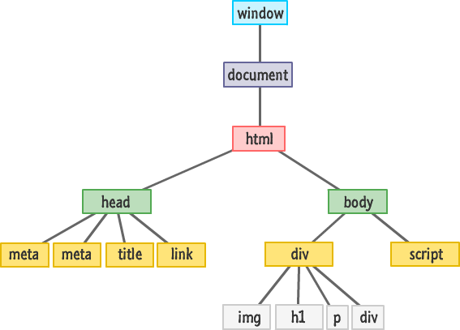
Document Object Model
A programming interface for HTML and XML documents
HTML elements are treated as a tree, with nodes, branches and leaves.
Allows creating, editing and deleting HTML elements using javascript

Slide 3
Retrieving and accessing an element
var mainWrapper = document.getElementById('elementId'); var elementsWithSameClass = document.getElementsByClassName('same-class'); var elementsWithSameTag = document.getElementsByTagName('same-tag'); for (var i = 0; i < elementsWithSameClass.length; i++) { var element = elementsWithSameClass[i]; }

Slide 4
Modifying an element
var mainWrapper = document.getElementById('elementId'); console.log(mainWrapper.innerHTML); mainWrapper.innerHTML = 'Some value'; mainWrapper.getAttribute('attribute-name'); mainWrapper.setAttribute('attribute-name', 'value'); mainWrapper.setAttribute('class', 'new-class'); console.log(mainWrapper.style.backgroundColor); mainWrapper.style.backgroundColor = '#49c'; mainWrapper.classList.contains('some-class'); mainWrapper.classList.add('some-class'); mainWrapper.classList.remove('some-class');

Slide 5
Creating an element
var parent = document.getElementById('main'); var element = document.createElement('div'); // Or any tag name element.innerHTML = 'Some value'; element.style.color = '#424242'; parent.appendChild(element); // Add to document parent.removeChild(element); // Remove from parent

Slide 6
Accessing parent and child nodes
var element = document.getElementById('main'); var children = element.childNodes; var parent = element.parentNode;

Slide 7
Event Handling: Method 1
var element = document.getElementById('main'); element.onclick = function(e) { // do something console.log(e.target); } element.onkeydown = function(e) { // do something console.log(e.key, e.code); }

Slide 8
Event Handling: Method 2
var element = document.getElementById('main'); element.addEventListener('click', function(e) { // do something console.log(e.target); }); element.addEventListener('keydown', function(e) { // do something console.log(e.key, e.code); });

Slide 9
Event Handling: Removing an event handler
var element = document.getElementById('main'); var clickHandler = function(e) { // do something console.log(e.target); } element.addEventListener('click', clickHandler); element.removeEventListener('click', clickHandler);

Slide 10
Common Events
click
dblclick
mouseup
mousedown
mousemove
mouseover
mouseout
change
keydown
keyup
keypress
focus
blur

Slide 11
And that's it.

